Slide 1

Analysis and prediction of average temperature based on meteorological data
Mid Bootcamp Project
L. T. OZGUR YILDIRIM
Ironhack
Data Analytics Bootcamp
October 7th, 2022
Notes:
Hello everyone. Today, I will discuss my mid bootcamp project about analysis and prediction of average temperature based on meteorological data.

Slide 2
Outline
Introduction
Materials and Methods
Results and Discussion
Conclusion
Notes:
Here is the outline of the presentation. Firstly, I will introduce the topic. Then, I will talk about the materials and methods. After that, I will show and discuss the results. Finally, I will conclude the presentation.

Slide 3
Introduction
This study analyses and predicts the average temperature of two European cities, Dusseldorf and Muenchen in Germany using machine learning models. Dataset consists of meteorological data ranging from 2000 to 2010.
The main objectives of this study include the following investigations:
Analyzing relationships between meteorological parameters
Hypothesis testing to decide whether the data sufficiently support the hypothesis
Building linear and logistic regression models and time series forecasting to predict the average temperature
Dusseldorf data: train the linear regression model + develop logistic regression model + time series forecasting
Muenchen data: test the linear regression model
Notes:
This study analyses and predicts the average temperature of two European cities, Dusseldorf and Munich in Germany using machine learning models. Dataset consists of meteorological data which ranges from 2000 to 2010.
The main objectives of this study include the following investigations:
Analyzing relationships between meteorological parameters
Hypothesis testing to decide whether the data sufficiently support the hypothesis
Building linear regression and logistic regression models to predict the average temperature
In this case, the Dusseldorf data and Munich data are used to train and test the linear regression model, respectively. Additionally, logistic regression model is developed using Dusseldorf data.

Slide 4
Materials and Methods
Meteorological parameters in the dataset are average temperature, precipitation, humidity, cloud cover, wind speed, sunshine, and barbeque weather. The studies are performed on .csv and excel files using Python, Mysql, and Tableau softwares.
The methods of this study include the followings:
Get data
Exploratory data analyses
Data cleaning
Data visualization
Hypothesis testing
Data wrangling
Build model
One-sided hypothesis testing: 11.17 C is the avg. temperature in Dusseldorf between 2000-2009.
Null hypothesis: avg. temperature in Dusseldorf between 2000-2010 =< 10.8 C
Alternative hypothesis: avg. temperature in Dusseldorf between 2000-2010 > 10.8 °C
°
°
×
P-value: 9.57 10⁻⁴
Notes:
Meteorological parameters in the dataset are average temperature, precipitation, humidity, cloud cover, wind speed, wind gust, global radiation, sunshine, pressure, and barbeque weather. Here, the precipitation and temperature data are observed from 2000 to 2010. The analyses and predictions are performed on .csv and excel files using Python, Mysql, and Tableau softwares.
The methods of this study include the followings:
• Get data
• Exploratory data analyses
• Data cleaning
• Data visualization
• Hypothesis testing
• Data wrangling
• Build model
One sided hypothesis is created to be tested. Based on average temperature in Dusseldorf between 2000-20, the hypothesis tests if average temperature in Dusseldorf between 2000-2010 is more than 10.8 C. P-value suggest that the null hypothesis can be rejected.

Slide 5
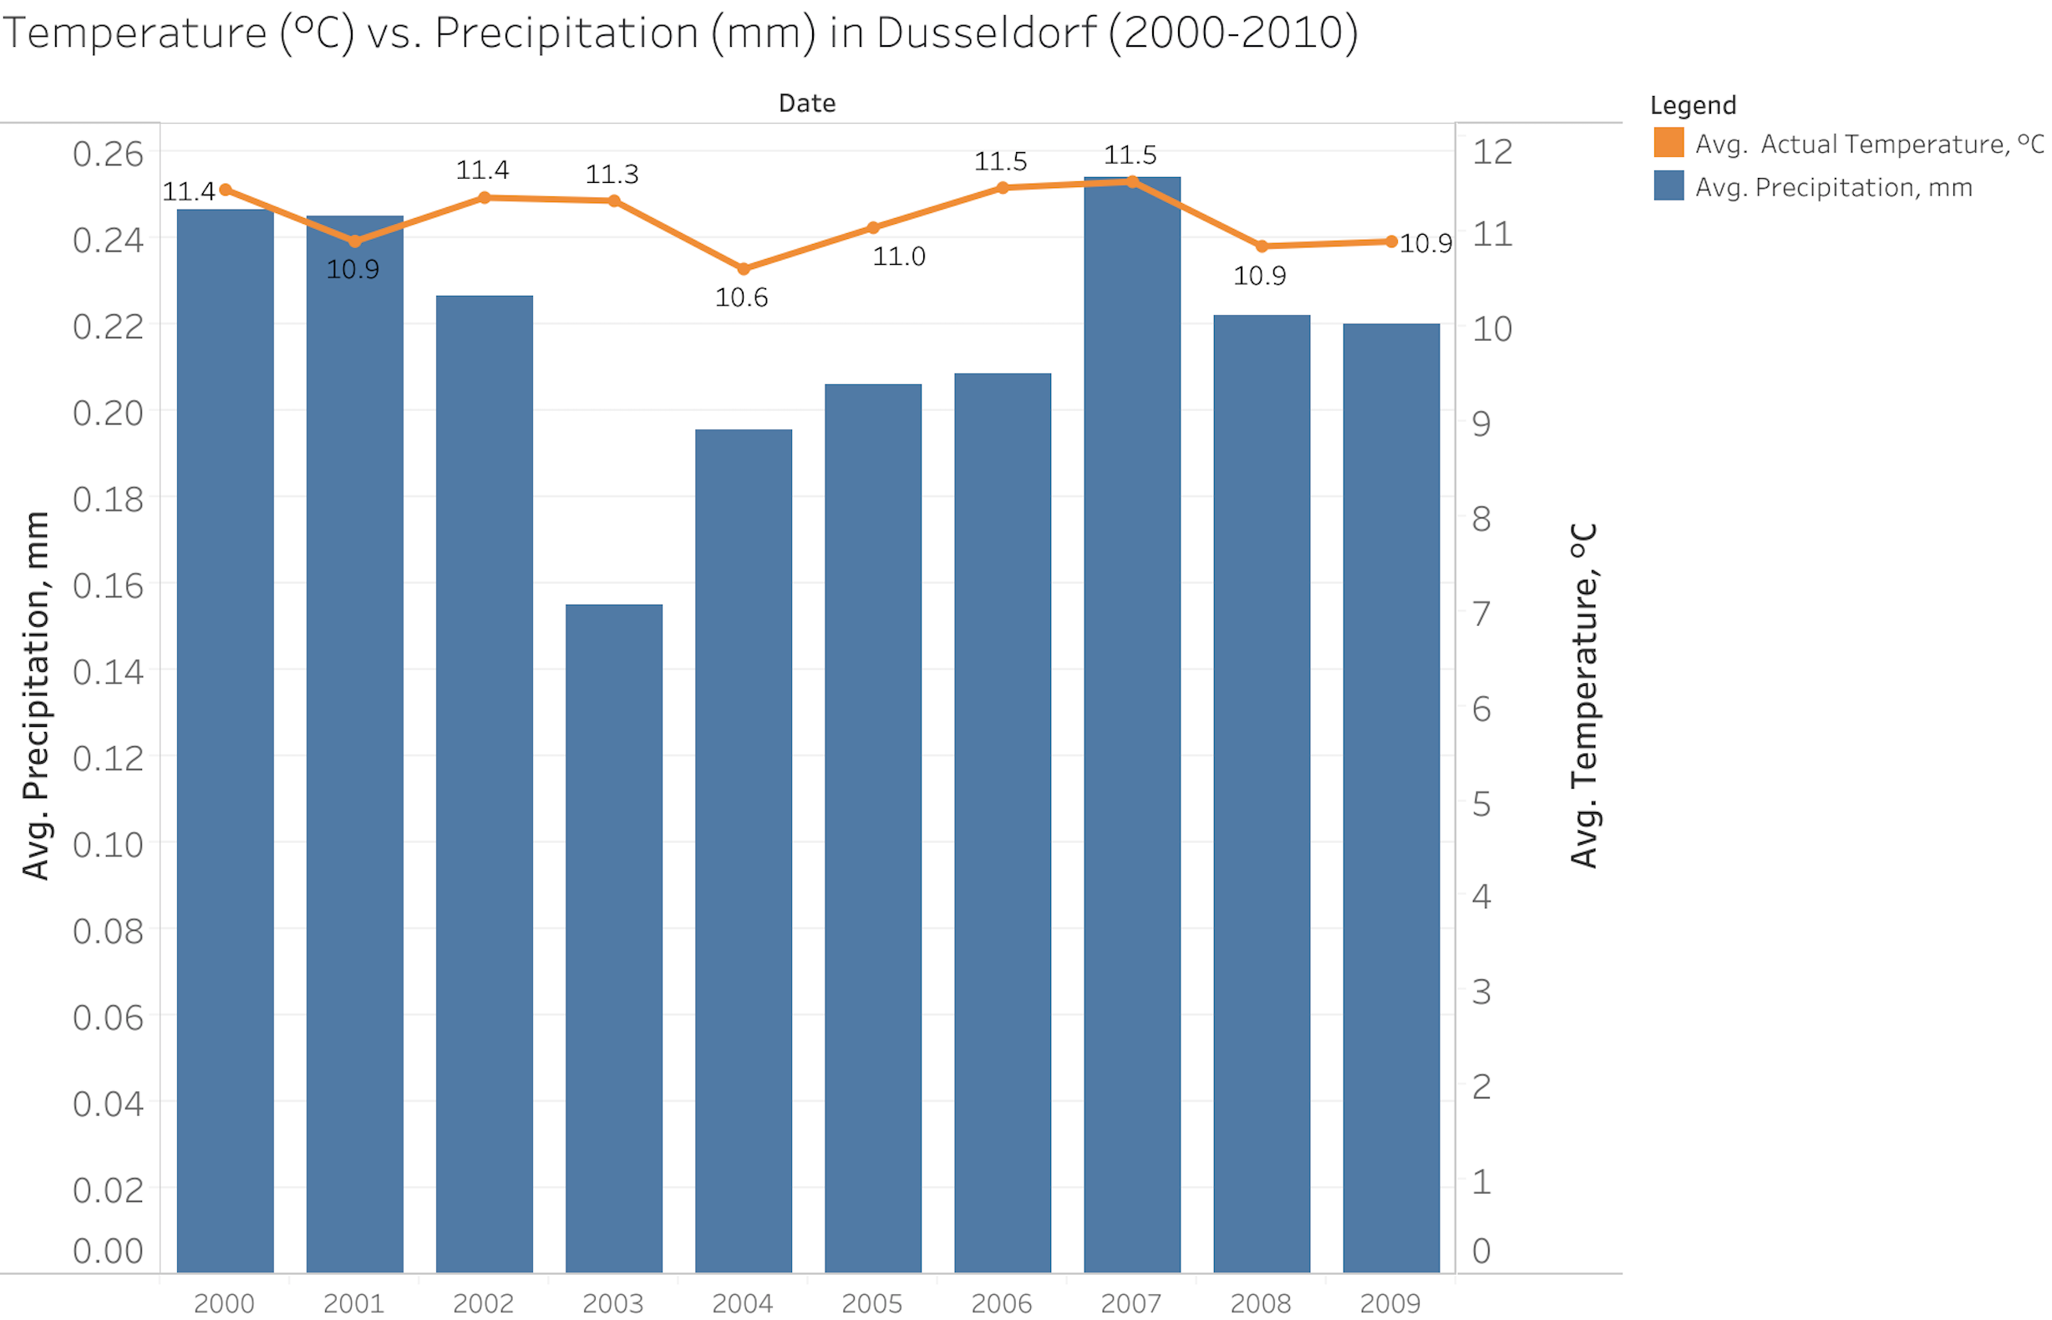
Materials and Methods
Notes:
Meteorological parameters in the dataset are average temperature, precipitation, humidity, cloud cover, wind speed, wind gust, global radiation, sunshine, pressure, and barbeque weather. Here, the precipitation and temperature data are observed from 2000 to 2010. The analyses and predictions are performed on .csv and excel files using Python, Mysql, and Tableau softwares.
The methods of this study include the followings:
• Get data
• Exploratory data analyses
• Data cleaning
• Data visualization
• Hypothesis testing
• Data wrangling
• Build model
One sided hypothesis is created to be tested. Based on average temperature in Dusseldorf between 2000-20, the hypothesis tests if average temperature in Dusseldorf between 2000-2010 is more than 10.8 C. P-value suggest that the null hypothesis can be rejected.

Slide 6
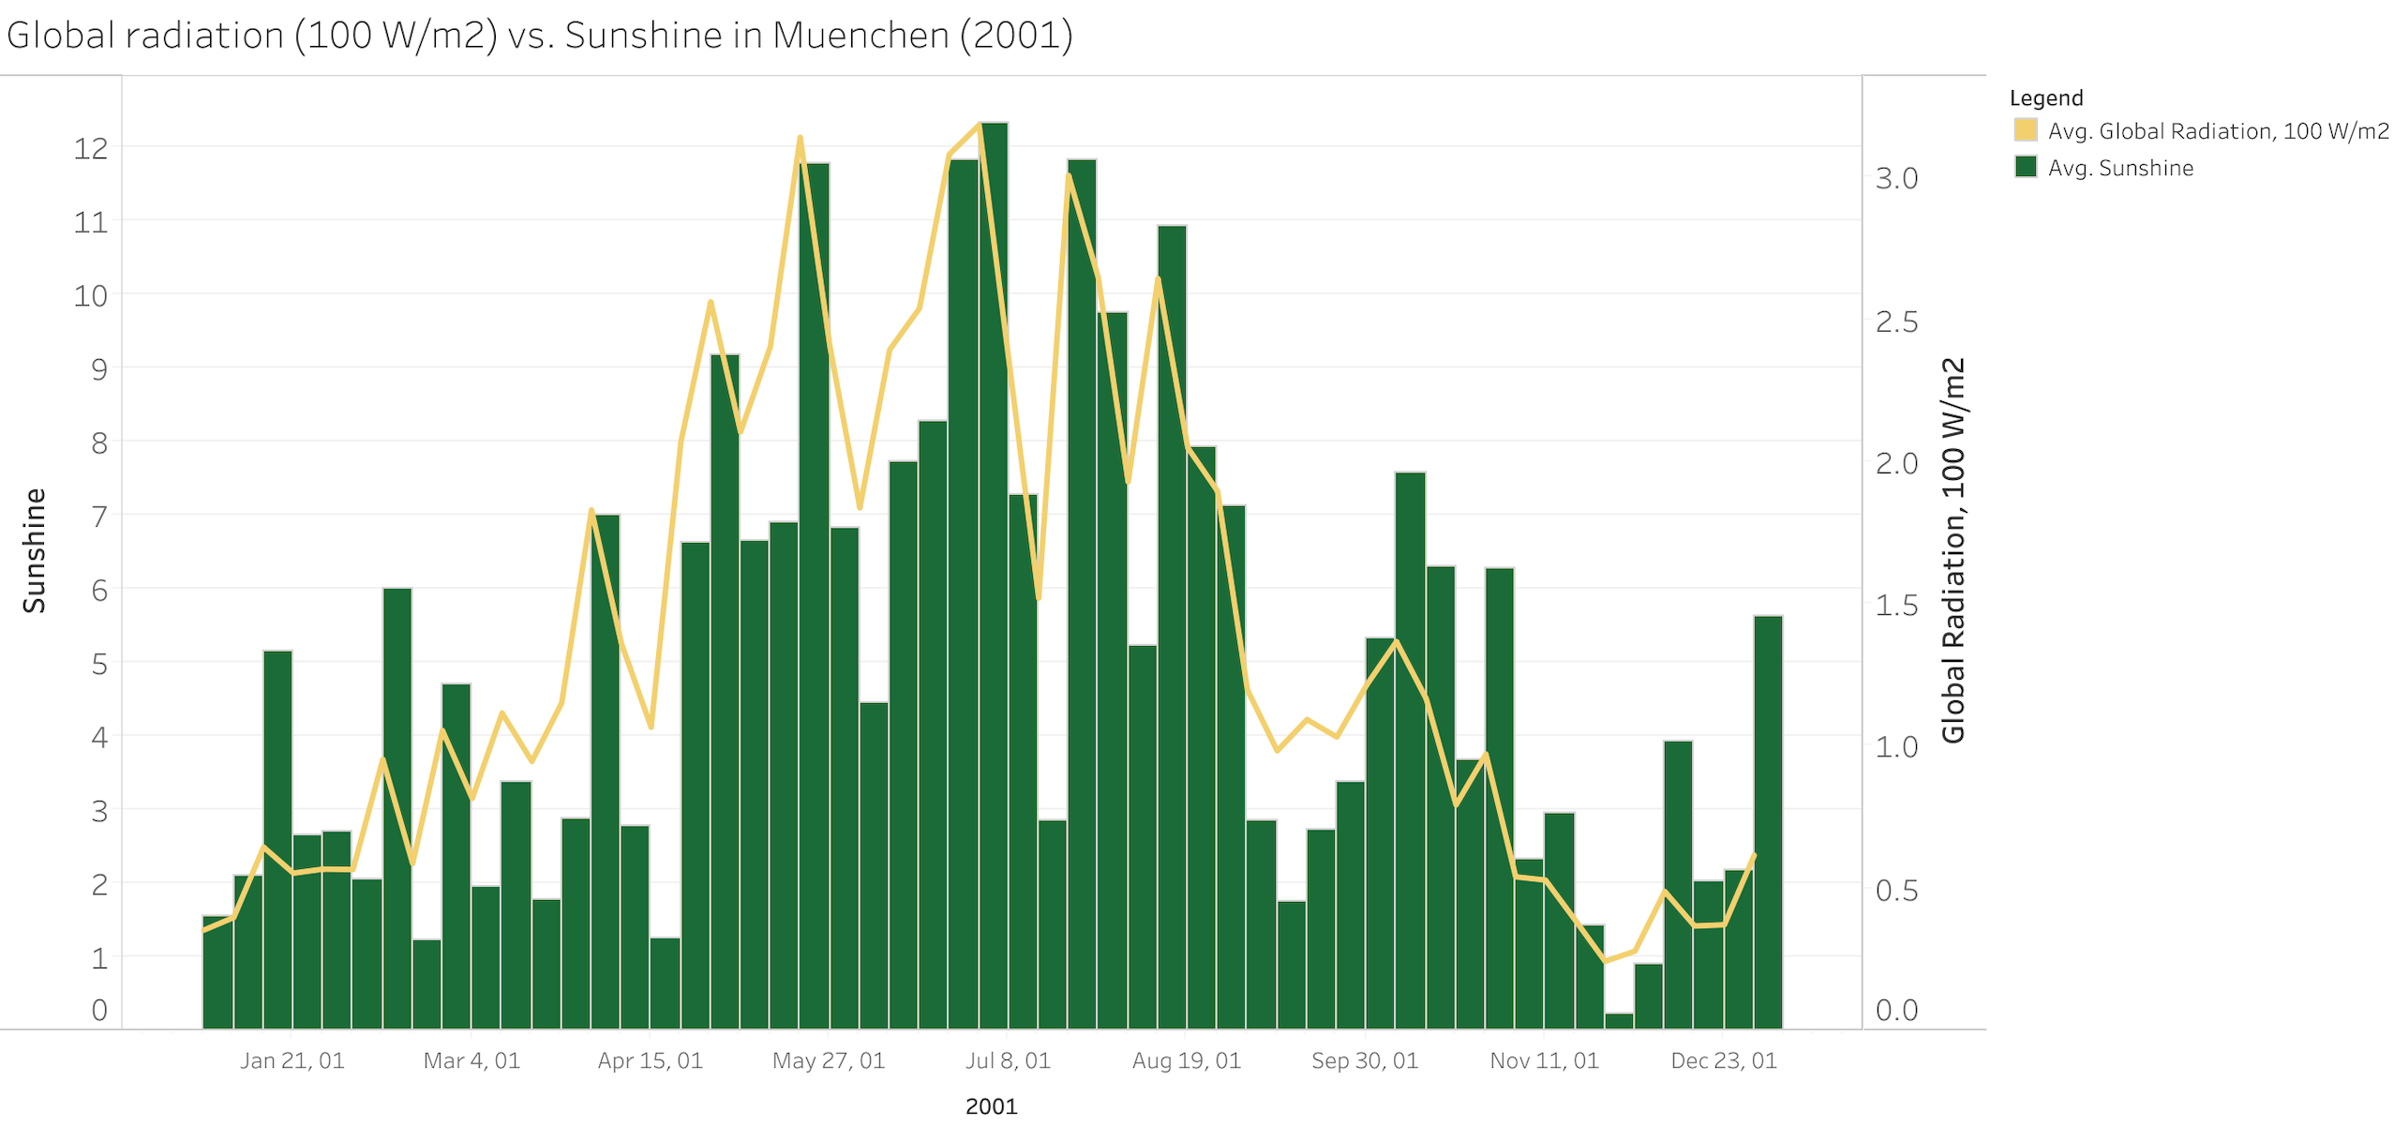
Materials and Methods
Notes:
Meteorological parameters in the dataset are average temperature, precipitation, humidity, cloud cover, wind speed, wind gust, global radiation, sunshine, pressure, and barbeque weather. Here, the precipitation and temperature data are observed from 2000 to 2010. The analyses and predictions are performed on .csv and excel files using Python, Mysql, and Tableau softwares.
The methods of this study include the followings:
• Get data
• Exploratory data analyses
• Data cleaning
• Data visualization
• Hypothesis testing
• Data wrangling
• Build model
One sided hypothesis is created to be tested. Based on average temperature in Dusseldorf between 2000-20, the hypothesis tests if average temperature in Dusseldorf between 2000-2010 is more than 10.8 C. P-value suggest that the null hypothesis can be rejected.

Slide 7
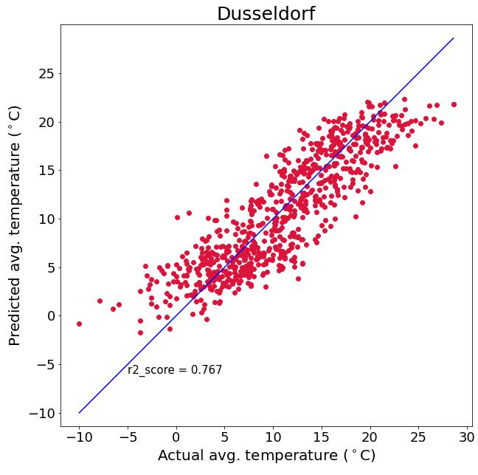
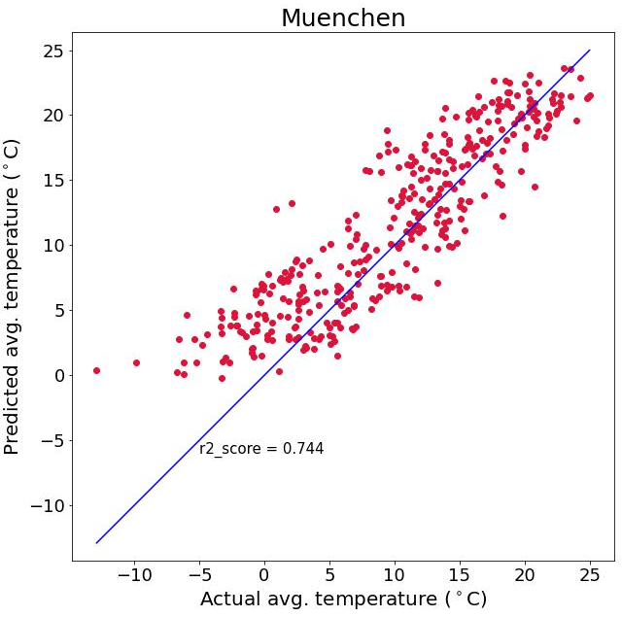
Results and Discussion
Linear regression model
Notes:
Here are the results of the linear regression model. Firstly, the model is trained using Dusseldorf data between 2000 and 2010. The predicted average temperature for Dusseldorf is 11.10 °C. And the r2 score is 0.77.
After that, the model is tested with Muenchen data for 2001. The predicted annual temperature for Muenchen is 11.50 °C. The r2 score of test is a little bit lower than that of the train. Because the model is tested with data that the model has not seen before.
Our model predicts the average temperature well. The r2 score decreased up to 0.74 since the meteorological parameters making very high correlation were removed from the model such as minimum and maximum temperatures.

Slide 8
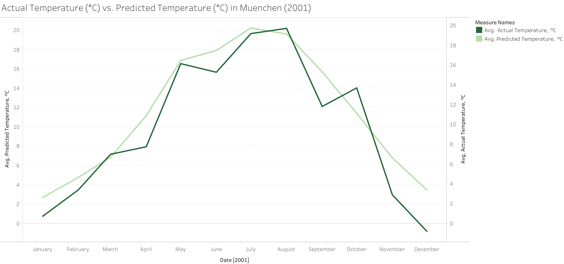
Results and Discussion
Linear regression model
Notes:
Here are the results of the linear regression model. Firstly, the model is trained using Dusseldorf data between 2000 and 2010. The predicted average temperature for Dusseldorf is 11.10 °C. And the r2 score is 0.77.
After that, the model is tested with Muenchen data for 2001. The predicted annual temperature for Muenchen is 11.50 °C. The r2 score of test is a little bit lower than that of the train. Because the model is tested with data that the model has not seen before.
Our model predicts the average temperature well. The r2 score decreased up to 0.74 since the meteorological parameters making very high correlation were removed from the model such as minimum and maximum temperatures.

Slide 9
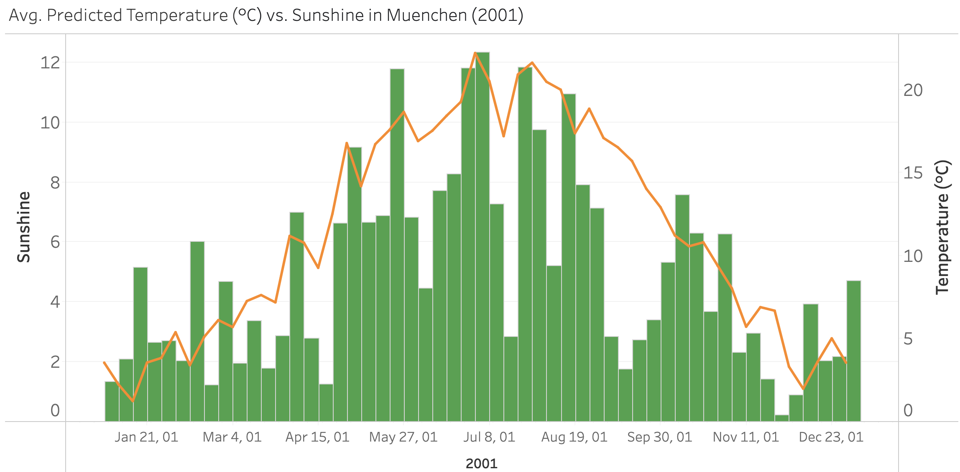
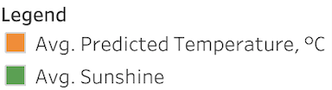
Results and Discussion
Notes:
Here are the predicted temperatures in Muenchen for 2001 and their relationship with sunshine. The temperature increases with increasing sunshine during summer.

Slide 10
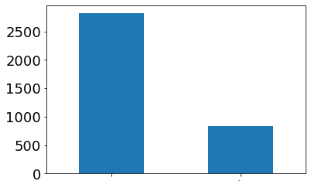
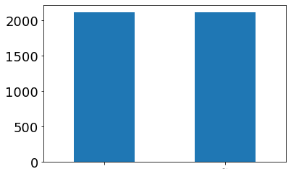
Results and Discussion
Logistic regression model
Unevenly distributed data : no barbeque in Dusseldorf in 80% of the days between 2000-2010.
Data is manipulated.
Logistic regression score: 0.932.
Number od Days
Number od Days
No barbeque
Yes barbeque
No barbeque
Yes barbeque
 | Precision | Recall | F1
Before data manipulation | 0.87 | 0.83 | 0.85
After data manipulation | 0.80 | 0.97 | 0.87
Notes:
Logistic regression model is applied for Dusseldorf data. A new data was used for this purpose. This data gives information if weather is suitable to have outdoor activities such as barbeque. The data shows that people can’t make barbeque outside in 80% of the days between 2000-2010. This implies that the data is unevenly distributed. In this case, the data is manipulated to make it evenly distributed. The logistic regression model is applied before and after manipulation. The model score is 0.93 before manipulation. And high fraction of calculated performance metrics here implies that the model accurately predicts if the weather is suitable outside for activities such as barbeque.

Slide 11
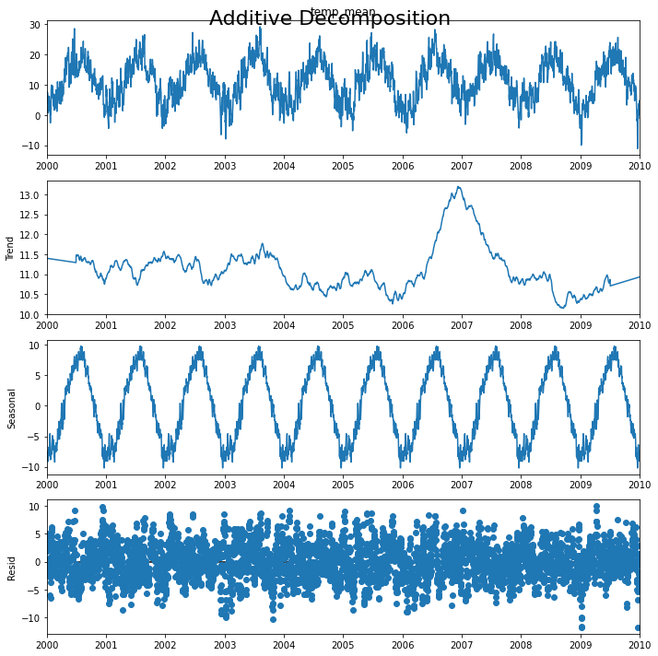
Results and Discussion
Time series forecasting
This plot shows that the temperature is unstable, along with its obvious seasonality.
Trend shows the overall direction of data.
Seasonality is a periodic component. It shows fluctuation in a the temperature sequence.
The difference between trend and seasonal is residual.
Notes:
Logistic regression model is applied for Dusseldorf data. A new data was used for this purpose. This data gives information if weather is suitable to have outdoor activities such as barbeque. The data shows that people can’t make barbeque outside in 80% of the days between 2000-2010. This implies that the data is unevenly distributed. In this case, the data is manipulated to make it evenly distributed. The logistic regression model is applied before and after manipulation. The model score is 0.93 before manipulation. And high fraction of calculated performance metrics here implies that the model accurately predicts if the weather is suitable outside for activities such as barbeque.

Slide 12
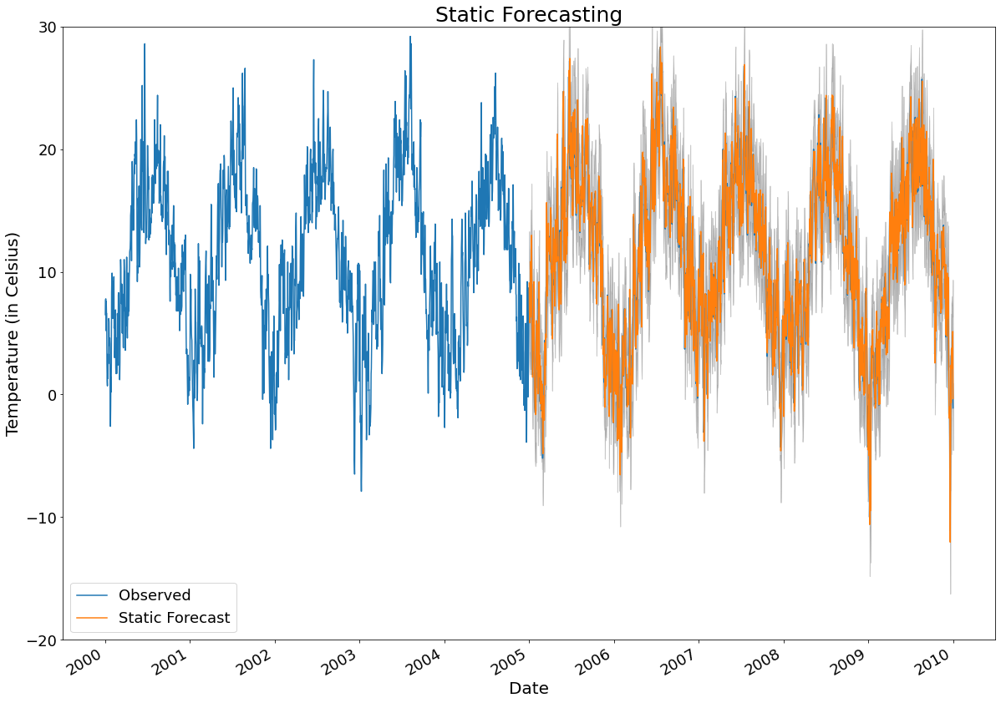
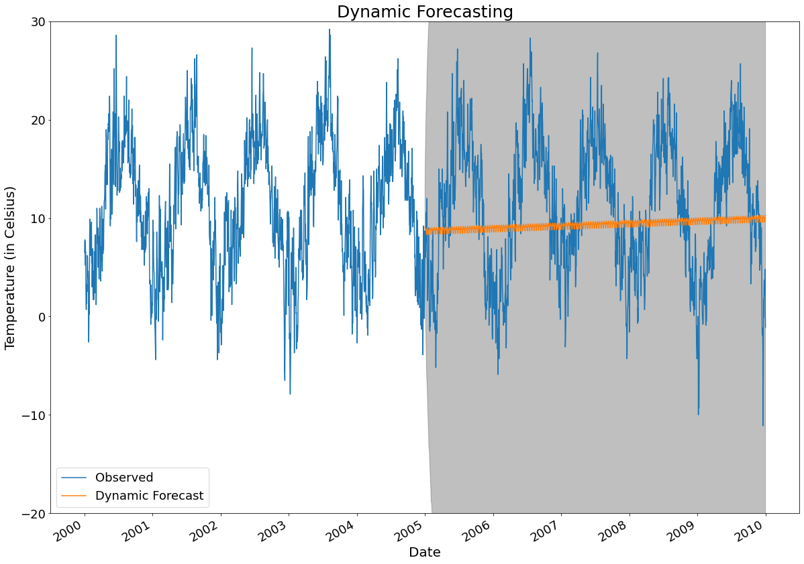
Results and Discussion
Time series forecasting
Time and average temperature of Dusseldorf between 2000-2010 are used for time series forecasting.
ARIMA Model => The RMSE of static forecasting: 2.09 and the RMSE of dynamic forecasting: 7.00.
Notes:
Logistic regression model is applied for Dusseldorf data. A new data was used for this purpose. This data gives information if weather is suitable to have outdoor activities such as barbeque. The data shows that people can’t make barbeque outside in 80% of the days between 2000-2010. This implies that the data is unevenly distributed. In this case, the data is manipulated to make it evenly distributed. The logistic regression model is applied before and after manipulation. The model score is 0.93 before manipulation. And high fraction of calculated performance metrics here implies that the model accurately predicts if the weather is suitable outside for activities such as barbeque.

Slide 13
Conclusion
This study investigates the average temperatures for Dusseldorf and Muenchen cities based on meteorological parameters using linear and logistic regression models.
The linear regression model (0.75 r2 score) predicts that Muenchen has annual temperature of 11.50 °C in 2001.
Logistic regression model is useful before making plans outside as it classifies if the weather is suitable for outdoor activities or not.
Based on RMSE values, static forecasting of ARIMA model (RMSE=2.09) predicts better than the linear regression model (RMSE=3.20) in this project.
Notes:
This study investigates the average temperatures for Dusseldorf and Muenchen cities based on meteorological parameters using linear and logistic regression models.
The linear regression model (0.75 r2 score) predict that Muenchen has annual temperature of 11.50 °C in 2001.
Logistic regression model is useful before making plans outside as it classifies the weather if it is suitable for outdoor activities or not.

Slide 14
References
Klein Tank, A.M.G. and Coauthors, 2002. Daily dataset of 20th-century surface air temperature and precipitation series for the European Climate Assessment.
Lai, 2020. Time Series Analysis and Weather Forecast in Python. Retrieved from: https://medium.com/@llmkhoa511/time-series-analysis-and-weather-forecast-in-python-e80b664c7f71.

Slide 15
Thank you!
Questions and Comments
Ironhack
Data Analytics Bootcamp

